Slide 1

BENBELLAH OWINO
PHASE 3 CLASSIFICATION PROJECT
LOAN APPROVAL MODEL

Slide 2



ABOUT THE CLIENT
Mouz Bank is a rapidly expanding retail and commercial bank that prioritizes quick, ethical financing via online platforms. The bank is implementing data-driven algorithms to enhance credit choices, control risk, and guarantee equitable loan approvals in order to support its growing loan portfolio.

Slide 3

BUSINESS PROBLEM
Our client Mouz bank is looking for a clever way to simplify and streamline the loan approval procedure while upholding ethical lending standards. In order to achieve this goal, we will create a prediction model that analyzes applicant data and more effectively evaluates risk in order to automate and assist credit decision-making. The following model will serve as the basis for increasing approval speed, decreasing manual labor, improving decision consistency, and supporting Mouz Bank's objective of providing quicker and more equitable loan outcomes

Slide 4

PROJECT OBJECTIVES
We want a model that satisfies the following thresholds
1. Minimum f1 score of 90%
2. Recall f1 score of 90%
3. Minimum precision score of 90%
We have very high thresholds because the model will operate in a high risk high reward environment so we want to minimize the former while maximize the latter. Anything less than that is as good as useless. Also the model must be good in order not to affect customer satisfication negatively.

Slide 5

BASE MODEL
MODEL RESULTS
LOGISTIC REGRESSION
SCORE FALSE | METRIC | SCORE TRUE
0.87 | F1 | 0.92
0.87 | RECALL | 0.92
0.86 | PRECISION | 0.92
TEST - 0.902 | ACCURACY | TRAIN - 0.923
Our base model is a logistic regression model from sklearn
We chose this model since it is simple and computationally efficient, so it’s very good for a base model.

Slide 6
MODEL 2
MODEL RESULTS
DECISION TREE
SCORE FALSE | METRIC | SCORE TRUE
0.97 | F1 | 0.98
0.96 | RECALL | 0.99
0.98 | PRECISION | 0.98
TEST - 0.98 | Accuracy | TRAIN - 1.00
This model is a Decision Tree classifier from sklearn
We chose this model since it maps well to the laon approval process for banks

Slide 7
MODEL 3
DECISION TREE
MODEL RESULTS
SCORE FALSE | METRIC | SCORE TRUE
0.97 | F1 | 0.98
0.96 | RECALL | 0.99
0.98 | PRECISION | 0.98
TEST - 0.98 | Accuracy | TRAIN - 1.00
This model is a Decision Tree classifier from sklearn
In this stage we did cross-validation, whereby we run the model numerous times with different parameters to find the best performing model thus effectively tuning it.

Slide 8

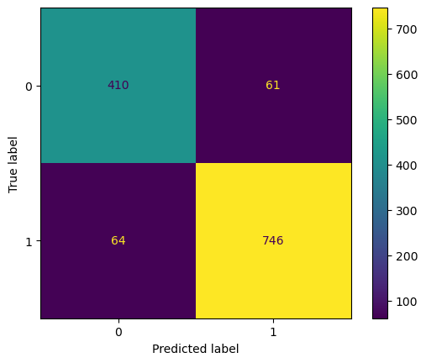
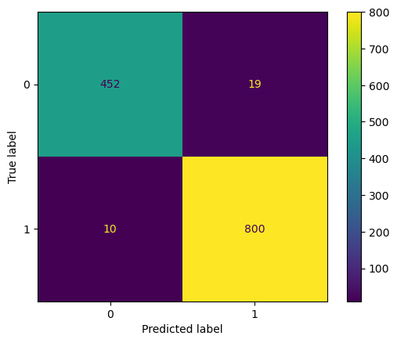

CONFUSION MATRICES
BASE MODEL
MODEL 2
MODEL 3
Your paragraph text
Approved correctly - 746
Approved falsely - 61
Rejected correctly - 410
Rejected wrongly - 64
Approved correctly - 800
Approved falsely - 19
Rejected correctly - 452
Rejected wrongly - 10
Approved correctly - 800
Approved falsely - 17
Rejected correctly - 454
Rejected wrongly - 10
The third model performs slightly better than the second one and both greatly outperform the base model.

Slide 9
CONCLUSION
1. The third model performs slightly better than the second one and both greatly outperforms the base model according to the metrics.
2. We will deploy the third model since it's the best performing model.
3. The model will do well to maximize revenue and customer satisfaction due to the reason above.
RECOMENDATIONS
  The model is ready for production.
  The bank should build an app/webapp to make it easier for the loan team to use the model.

Slide 10

THANK YOU

